Slide 1
Absent Appointments in Brazil Clinic analysis
Yanyan Deng

Slide 2
Introduction
In this reservation no-show project, we are looking at a 100k dataset of Brazil Medical Record.
We hope to understand what are the related factors that affect a patient's no-show.
By looking at the dataset, gender, scholarship and age are the three factors I would like to study.
In the below report, use data analysis and data visualization to find out the results.

Slide 3
Method
Python
import pandas as pd
import numpy as np
The two libraries, pandas and numpy, are used to make the data look like a table for easy processing. They are the most important libraries for data analysis with python.
import matplotlib.pyplot as plt
import seaborn as sns
These two libraries are used to draw pictures for data visualization

Slide 4
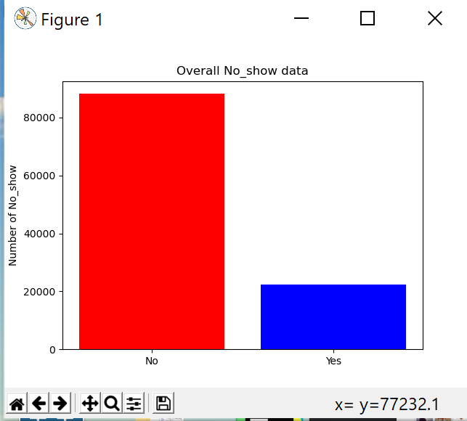
Analysis
The overall data, the number of absentees is 4 times the number of attendees

Slide 5
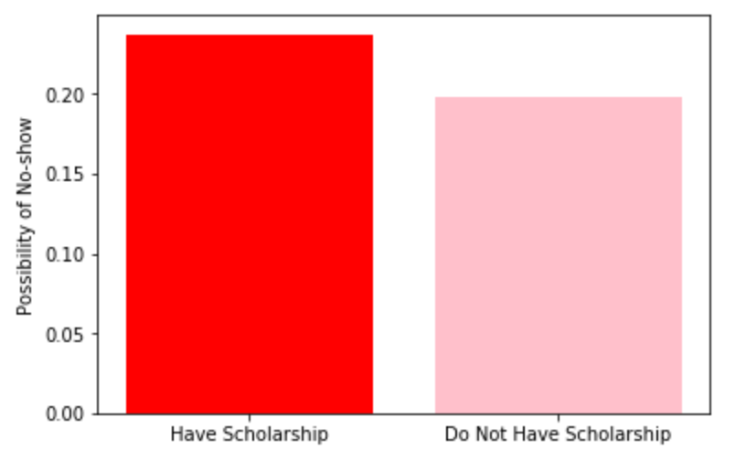
Analysis
Research 1: Scholarship and No-Show
We can see that people who have scholarship may have a higher rate of being no-show. This is probably because that people who have scholarship are generally in a less-favorable economic condition, so they may fear they do not have enough money for the hospital.
scholarship and probability of absence chart

Slide 6
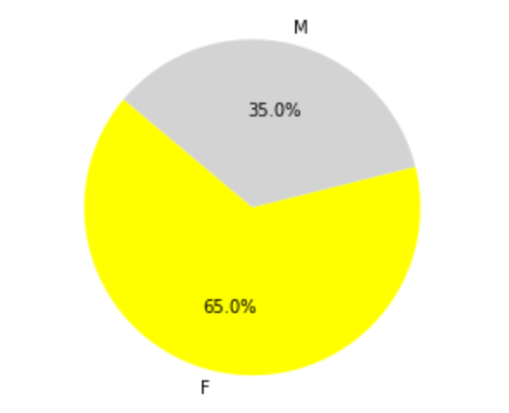
Analysis
Research 2：Gender and No-show
Based on this statistics, we can not see any association between gender and no-show.
Ratio of absenteeism between men and women

Slide 7
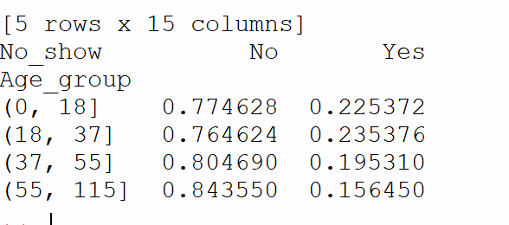
Analysis
Research 3：Age and No-show
Grouped according to age group, patients with 18-37 years old have the highest absent rate, followed by 0-18 years old, and the elderly have the least

Slide 8
Conclusions
Scholarship have a negative impact in patient's showing up, which can be due be the fact that a lot of scholarship goes to the less affluent population, thus people may fear it will take too much money to see the doctor;
No obvious difference between gender regarding the rate of no-show.
It seems more no-shows are from young people and the adult population, and elderly people have a seemingly fewer no-shows. This may be because the health conditions of the elderly population

